Slide 1
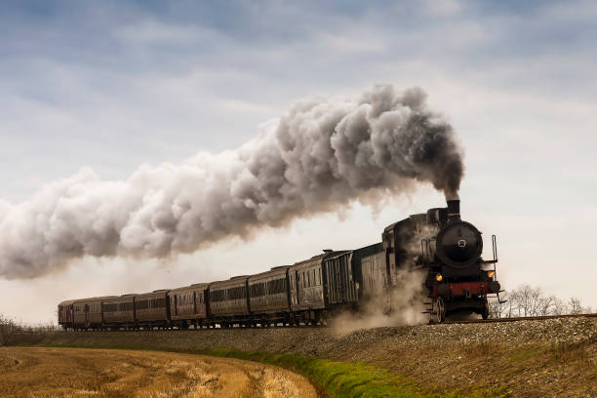
Train Ticket Booking

Slide 2
Team Structure
We are trying to implement a model for train ticket booking system. We have discussed about planning, designing and coding of the project and have a equal participation of all team members.
The team is comprised of five:
Surya S
Mehbish
Amrutha
Abijith
Mahantesh

Slide 3
Abstract
This project deals with reserving tickets for the local trains. So in order to make it convenient to travel we can book tickets. This makes the travel smooth and also helps in checking the details afterwards.

Slide 4
Introduction
The system is basically concerned with the reservation of railway tickets to the passengers. By developing a online ticketing system it will be convenient for the passengers to book tickets

Slide 5
Scope and objective
An Online Reservation system is the great way to provide online booking by the user(passenger).
Ticket allocation in a real time ensures there are no duplicate booking.
Our system is extremely ease to use which is resulting in time and efficiency due to that it saves a lot of time of user.
To make it easy for fast processing and modification.
To make railway system is interactive.

Slide 6
Modules
We have analysed and concluded that project can be implemented using 5 modules:-
Register and login
Book ticket
Add passenger
Payment
Add trains

Slide 7
Technology:
Software:
Frontend: HTML, CSS,JS
Backend : Java Spring boot
Database : Mysql
Hardware:
Operationg system : windows
Processor : intel
RAM:4GB

Slide 8
Module in detail
A) Register and log in
This the module one and this comprises of following subtasks:
i) Registration:
ii) Log in:

Slide 9
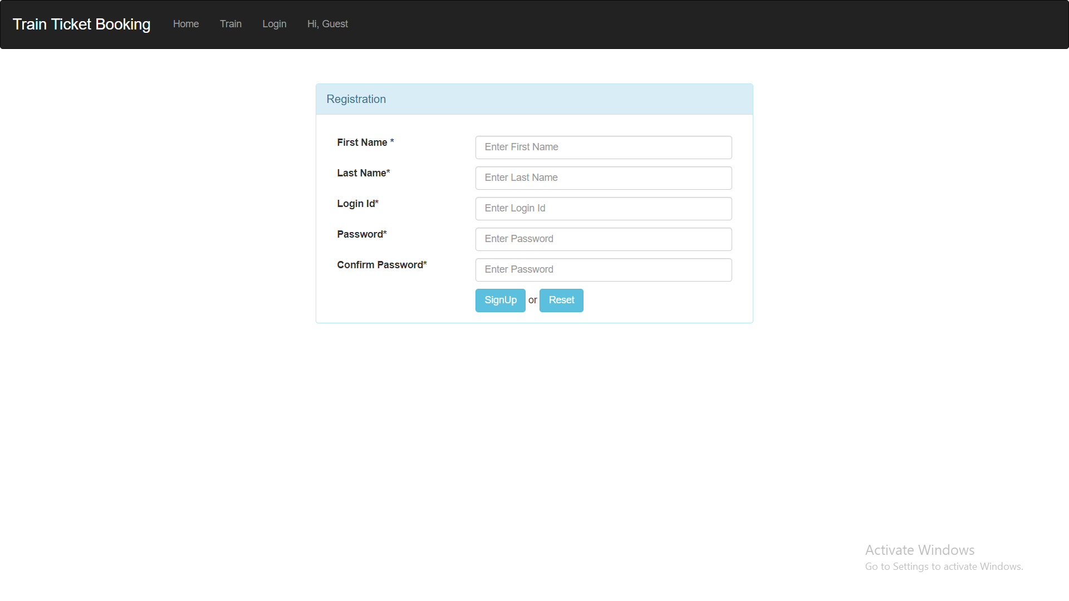
i) Register:
To add a new user to the application. To book the ttrainticket

Slide 10
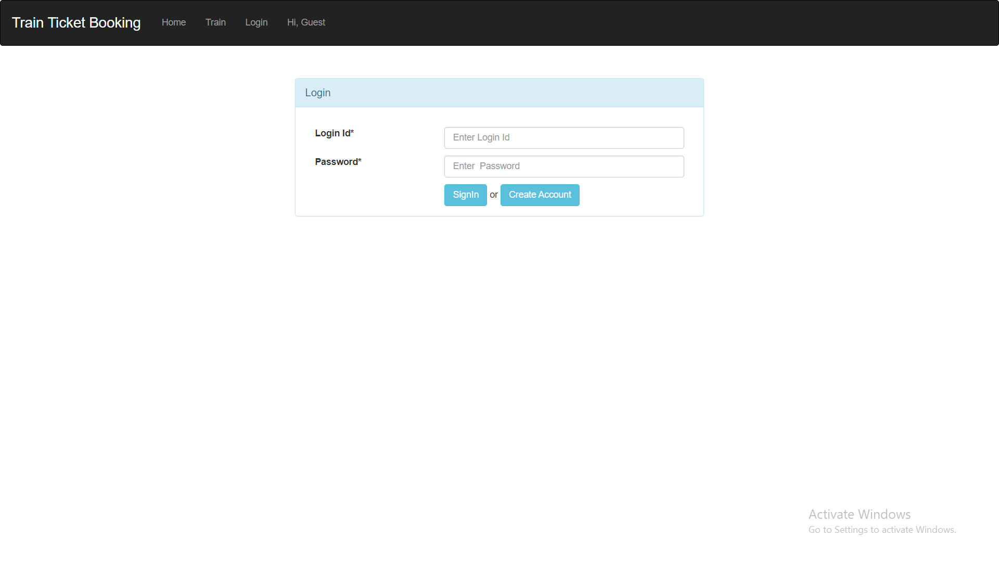
ii) Log in:
If the user register to the train ticket booking, a username and password are provided for login and the user can book tickets accordingly.

Slide 11
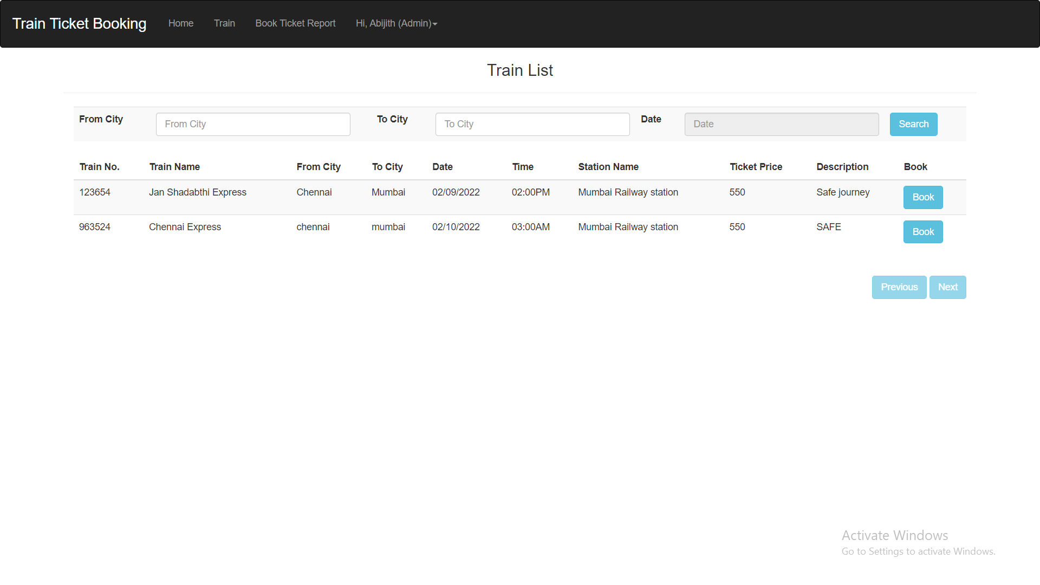
Module in detail
B) Book tickets:-
After logging in the user can book tickets by providing source and destination, date of travel and select the classes.

Slide 12
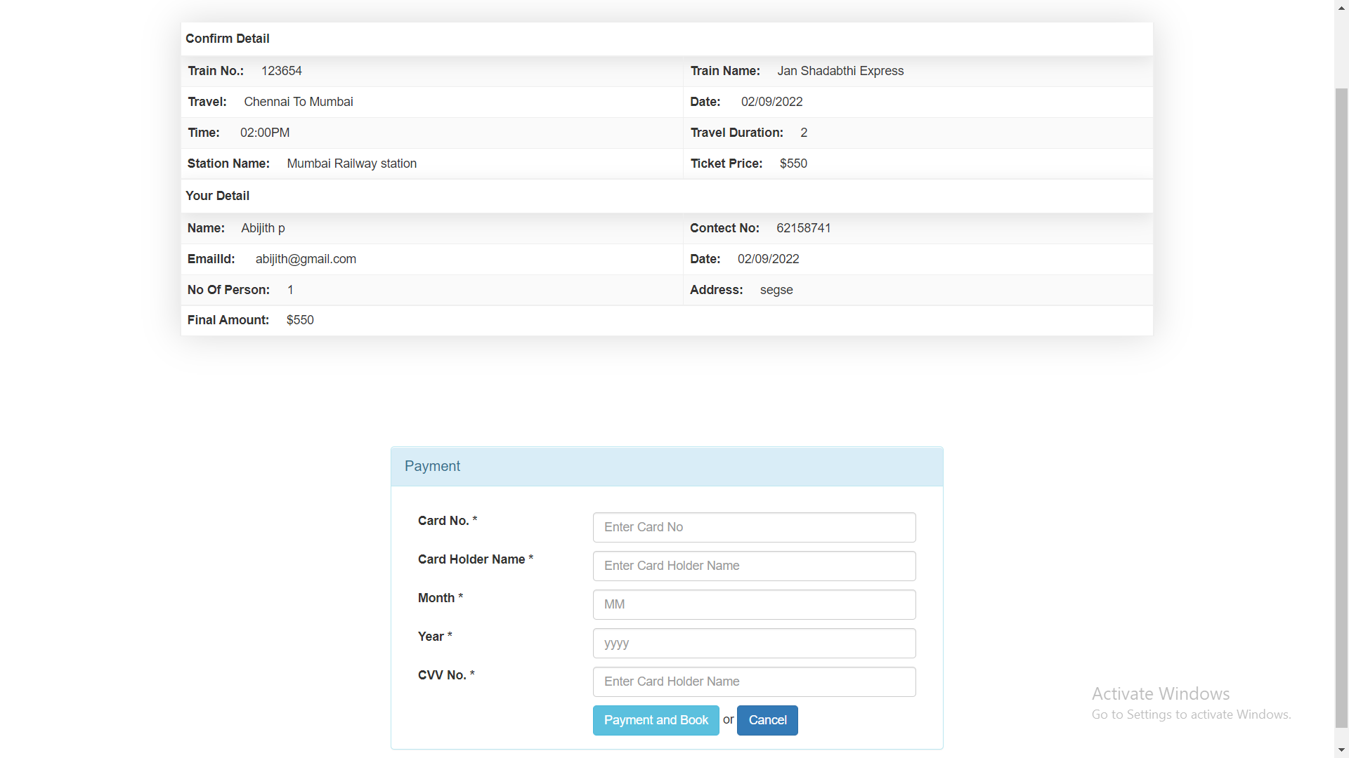
Module in detail
C) Payment gateway:
After adding the passenger detail the user should done payment by providing correct card details.

Slide 13
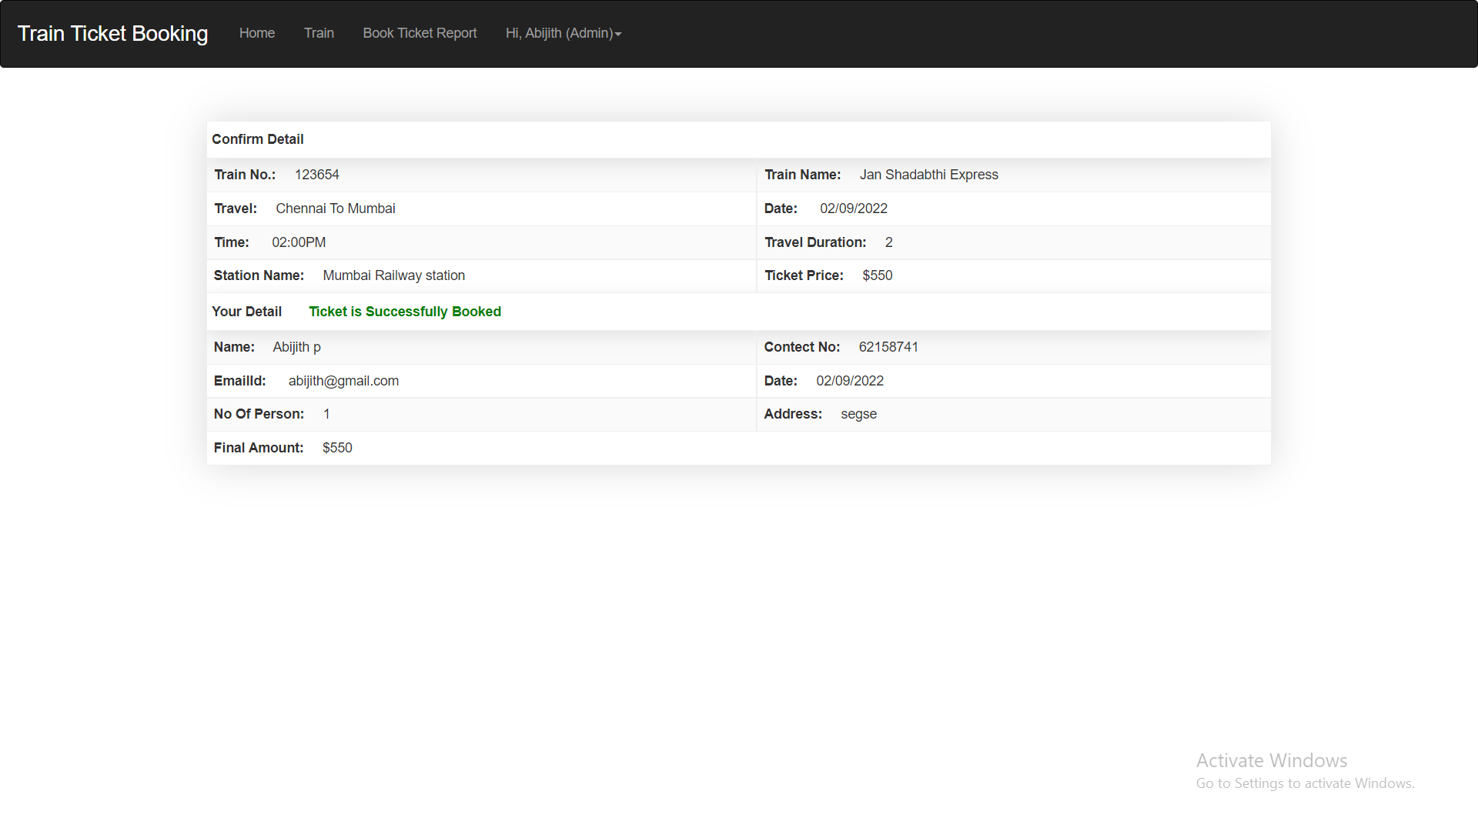

Slide 14
Module in detail
D) Add trains:
this module is governed by the admins. They can add new trains accordingly.

Slide 15
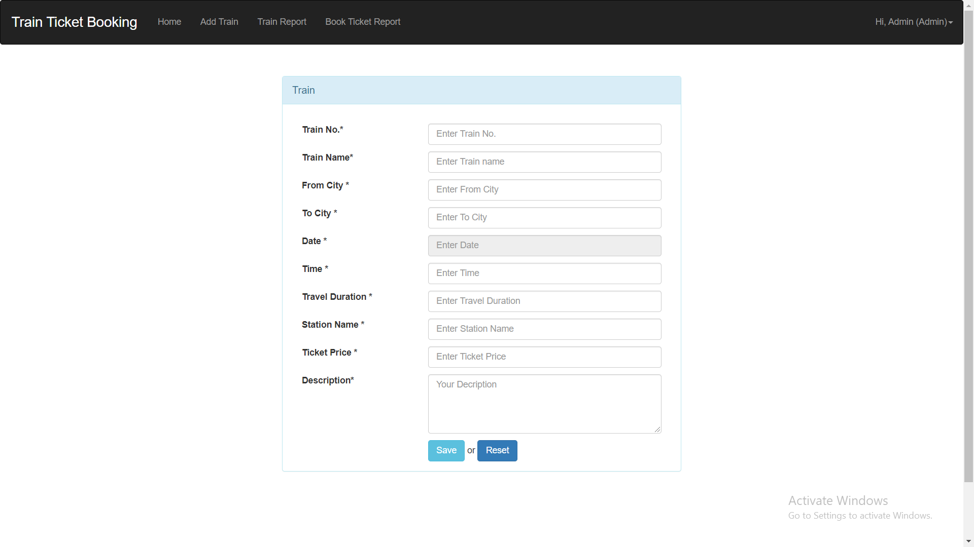

Slide 16
Conclusion
Train ticket reservation system is online system, which enable customer to check availability of Train ticket. It makes the customer easy to get train ticket instead of queue up to buy the train ticket. This concept of e-ticket should be widely applied in all the sector industry.

Slide 17
Thank you.

